Slide 1
Balancing Performance, Accuracy and Precision for Secure Cloud Transactions
Presented by Bhargav Krishna Lavu
Cwid: 802373670

Slide 2
Agenda
Introduction
Existing System
Proposed System
System Requirements
Purpose
Modules
Functionality of the Modules
Demo

Slide 3
Introduction
The practice of using a network of remote servers hosted on the Internet to store, manage, and process data, rather than a local server or a personal computer is called cloud computing.
One of the most appealing effects of cloud computing is its elasticity.
Cloud computing enables companies to consume compute resources as a utility just like electricity rather than having to build and maintain computing infrastructures in-house.
It doesn’t need a huge building or some physical department to store data for the processing or transaction of data.

Slide 4
Existing System
To provide scalability and elasticity, cloud services often make heavy use of replication to ensure consistent performance and availability.
As a result, many cloud services rely on the notion of eventual consistency when propagating data throughout the system.
This consistency model is a variant of weak consistency that allows data to be inconsistent among some replicas during the update process, but ensures that updates will eventually be propagated to all replicas.

Slide 5
Proposed System
By defining several different levels of policy consistency constraints and corresponding enforcement approaches that guarantee the trustworthiness of transactions executing on cloud servers.
propose a Two-Phase Validation Commit (2PVC) protocol that ensures that a transaction is safe by checking policy, credential, and data consistency during transaction execution.
Identifies transactions that are both trusted.
Guarantee the trustworthiness of transactions executing on cloud servers.
A transaction is safe by checking policy, credential, and data consistency during transaction execution .

Slide 6
System Requirements
Hardware Requirements
System : Pentium IV 2.4 GHz.
Hard Disk : 40 GB.
Monitor : 15 VGA Colour.
Mouse : Logitech.
Ram : 512 Mb.
Software Requirements
Operating system : Windows XP/7.
Coding Language : ASP.net, C#.net
Tool : Visual Studio 2010
Database : SQL SERVER 2008

Slide 7
Purpose (objective)
Main purpose of this application is to share information and knowledge universally.
To upload and download different types of files with different formatting making it easy for the users to upload a variety of file types.

Slide 8
Modules
Cloud User Module.
Cloud Administrator Module.
Cloud Admin Server Module.
Transaction Manager Module.

Slide 9
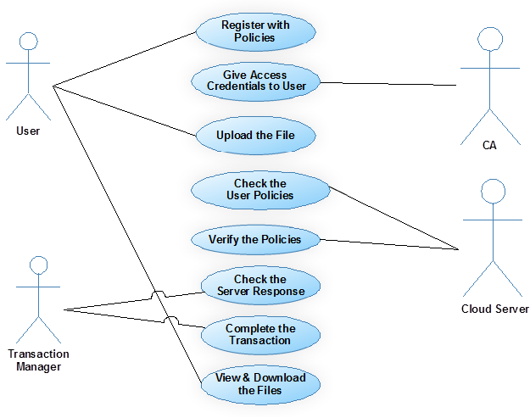
Functionality of the Modules

Slide 10
DEMO
Link to the website
http://localhost:49478/Home.aspx

Slide 11
Thank You

